Slide 1
Day 6
Behold Bootstrap!
April 8, 2016
Notes:
1

Slide 2


Slide 3
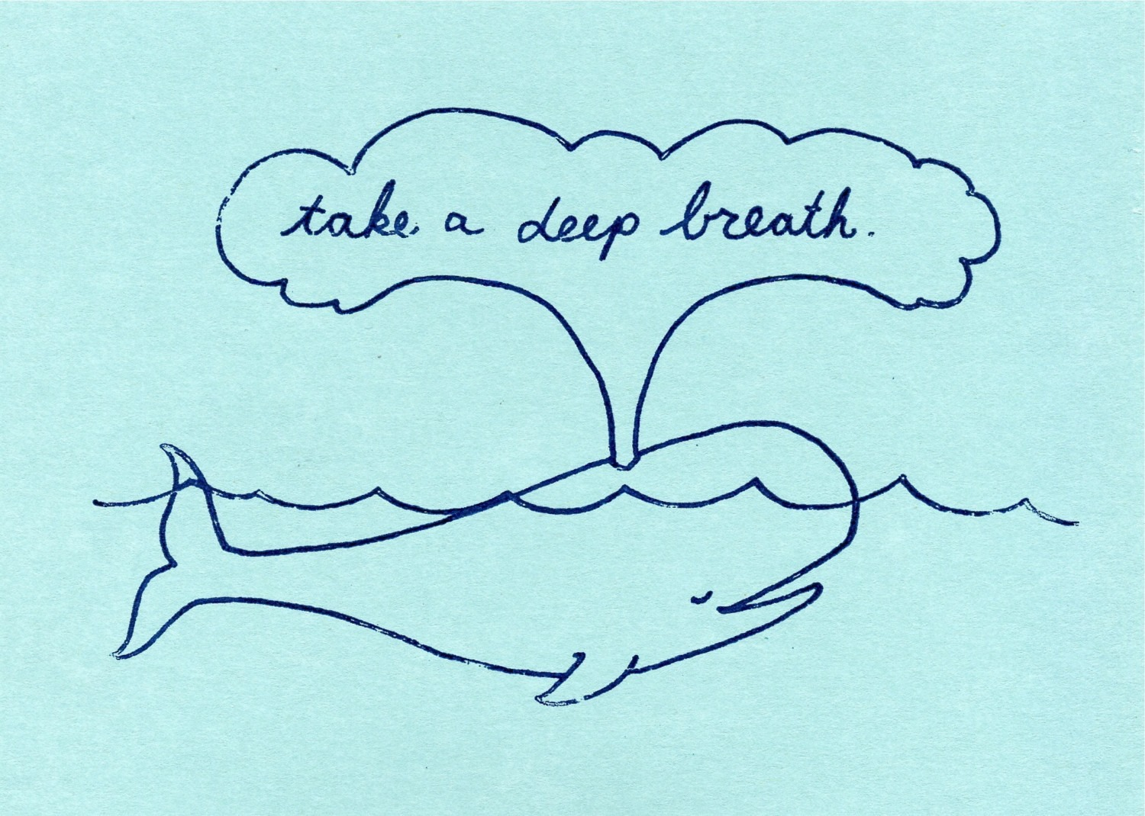

Slide 4
Objectives
Students will use Twitter Bootstrap to create layouts
Students will learn to use media queries for mobile responsive websites
Students will learn to use the viewport tag to make sure all devices are displaying web pages optimally

Slide 5
Recap Bootstrap
Notes:
5

Slide 6
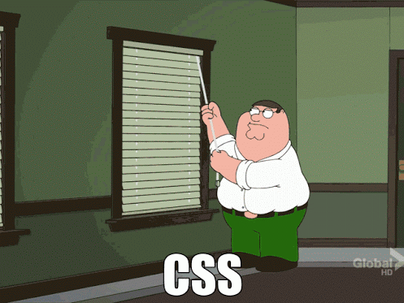
How You (Probably) Feel About CSS

Slide 7

But Then Came Bootstrap…
Notes:
7

Slide 8


Powered by Bootstrap
External CSS Link
Pre-Defined CSS Class (ex: “Jumbotron”)
Notes:
8

Slide 9

Why Use Bootstrap?
Reason #1: UI Kit
Familiarize yourself with the UI features it offers via the documentation.
Once Bootstrap is active, you can simply copy snippets from the documentation to save yourself major time of creating elements yourself.
Notes:
9

Slide 10

Why Use Bootstrap?
Reason #2: Mobile Responsiveness
One of the most compelling reasons to use Bootstrap is the default mobile-responsive quality it provides.
This means that your website will look “good” automatically when viewed on screens ranging from monitors to tablets to phones.
Notes:
10

Slide 11
> YOUR TURN!!
Warmup Activity:
As a repeat of last class, quickly create an HTML web page.
Then add in a Bootstrap component of your choosing.
Hint: Copy the Bootstrap CSS link. Then copy the code from any Bootstrap element or CSS.

Slide 12
Sketching / Grid Layouts
Notes:
12

Slide 13

Take a Huge Breath and Relax …….Then Focus!

Slide 14
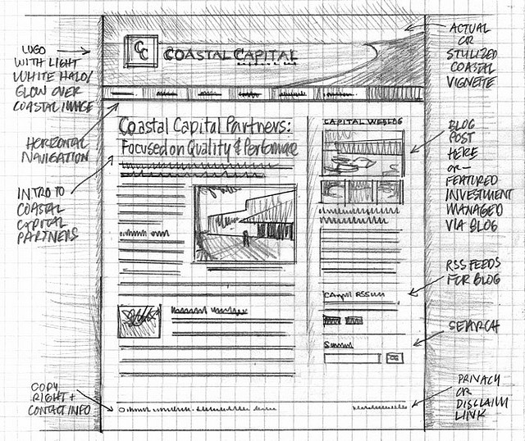
Importance of Sketches
Because every aspect of a site’s “look” is defined by HTML/CSS – it is crucial to have a detailed sketch going in.
Pay particular attention to the location of navigation bars, titles, headers, content, images, footers etc.
When imagining alignments, in particular, be mindful of the grid

Slide 15
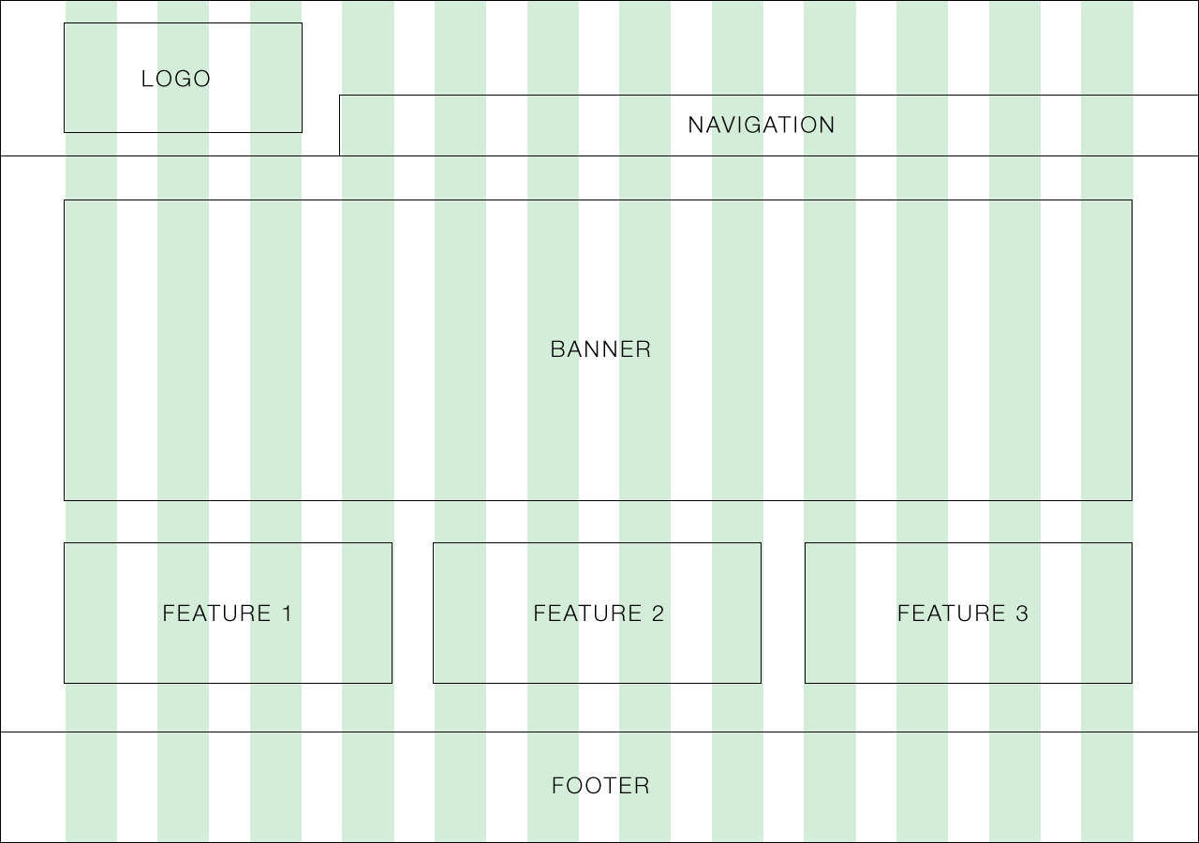
Designing with a Grid in Mind
Grids serve to align elements aesthetically.

Slide 16
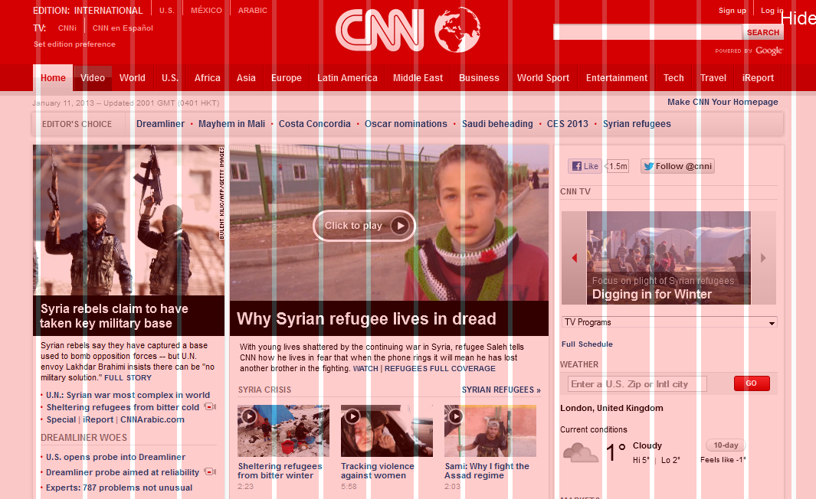
A More Complex Grid…

Slide 17
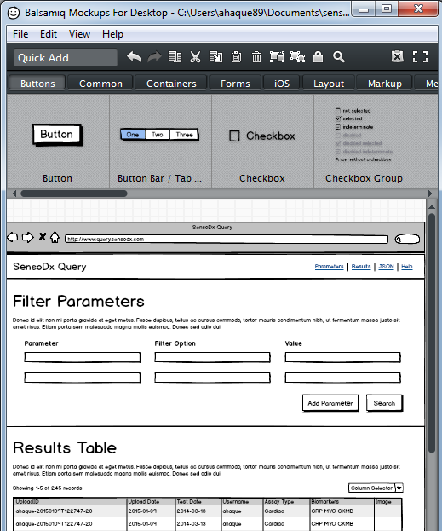
Tools for Sketch / Grid Creation
Wireframing Tools:
Balsamiq***: https://balsamiq.com/
Framebox: http://framebox.org/
Pen and Paper: Your notebook
Grids for Photoshop / Illustrator:
960 GS: http://960.gs/
GuideGuide: http://framebox.org/
Designing with Grids Guides:
960 Grid System Made Easy: http://bit.ly/1sjYaFC
Design by Grid: http://www.designbygrid.com/
Designing with Grid-Based Approach: http://bit.ly/1CM4Hzo

Slide 18
Rows and Columns
Workshop

Slide 19
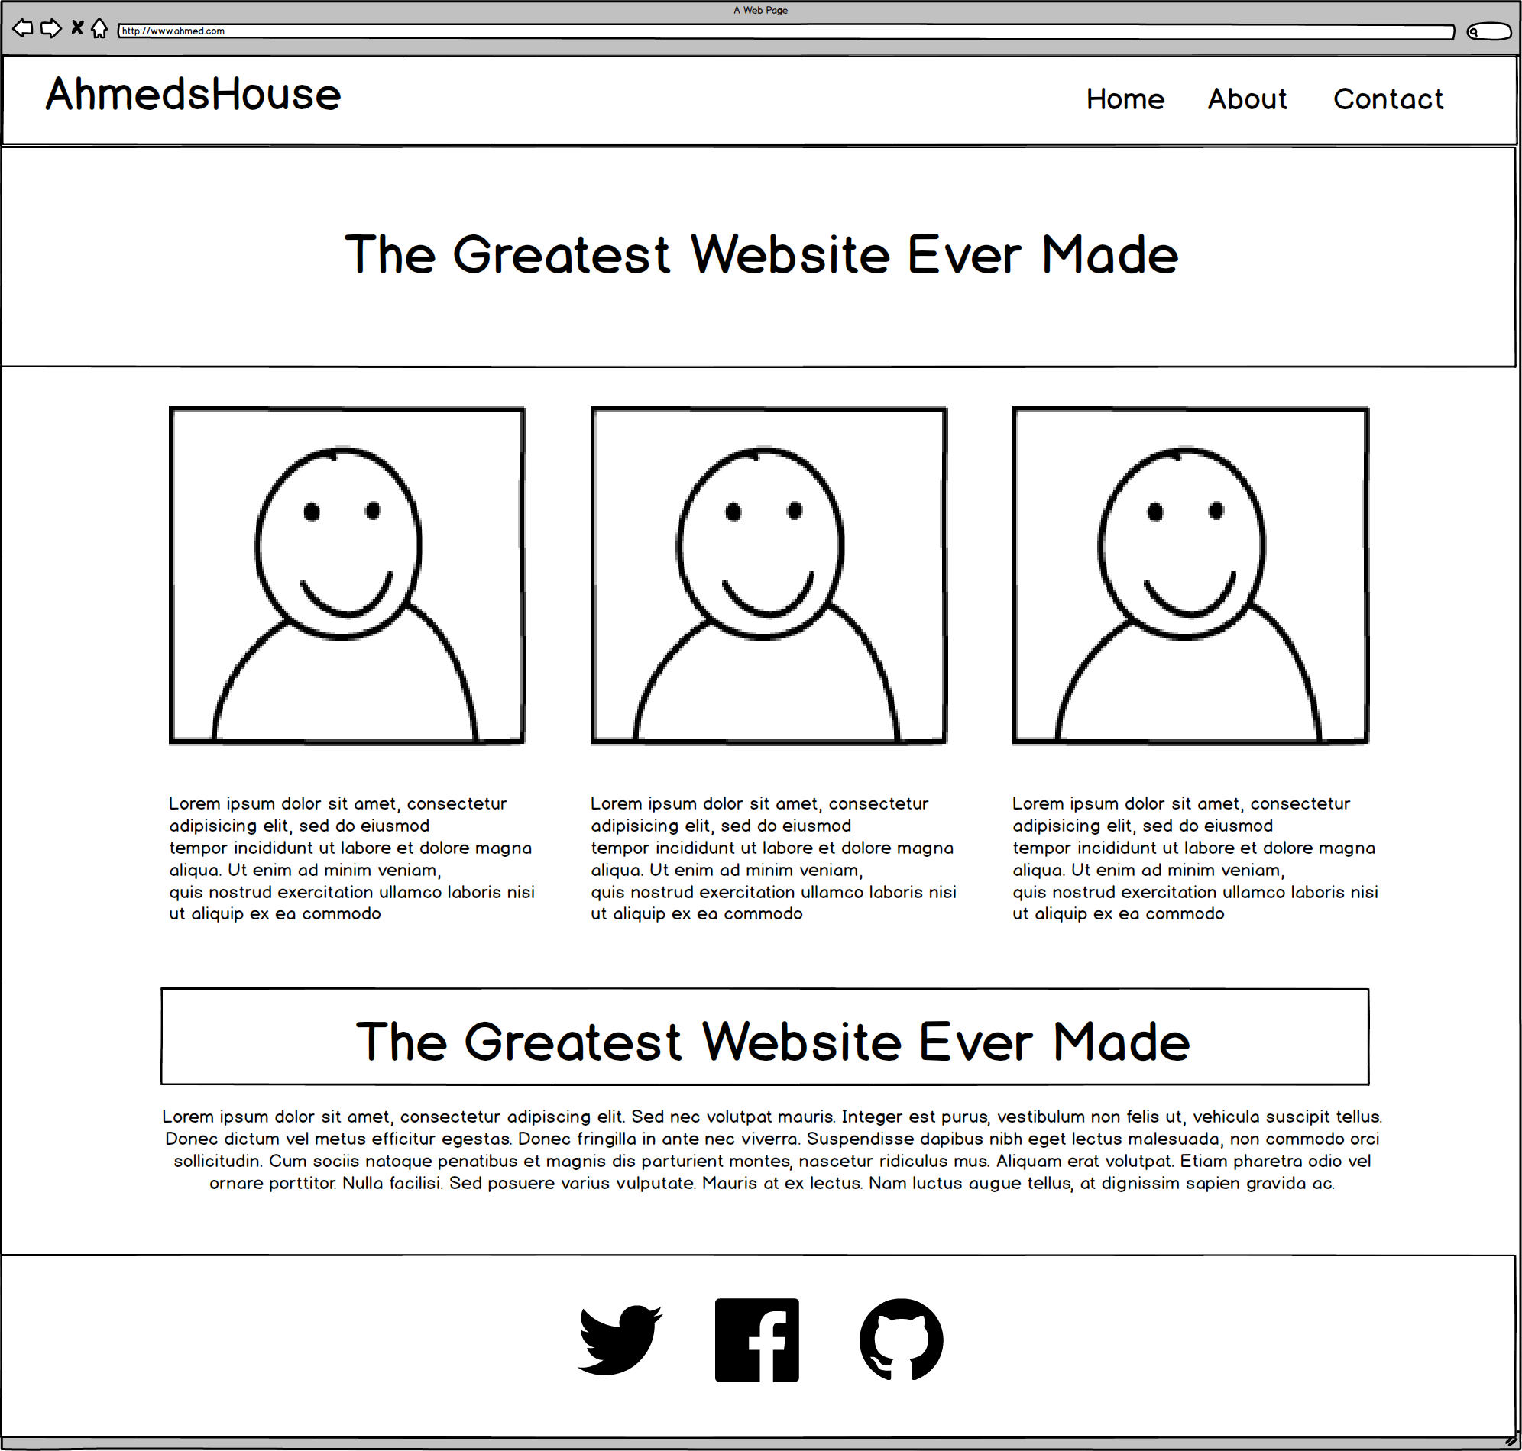
Web Design Fundamentally = Wireframes

Slide 20
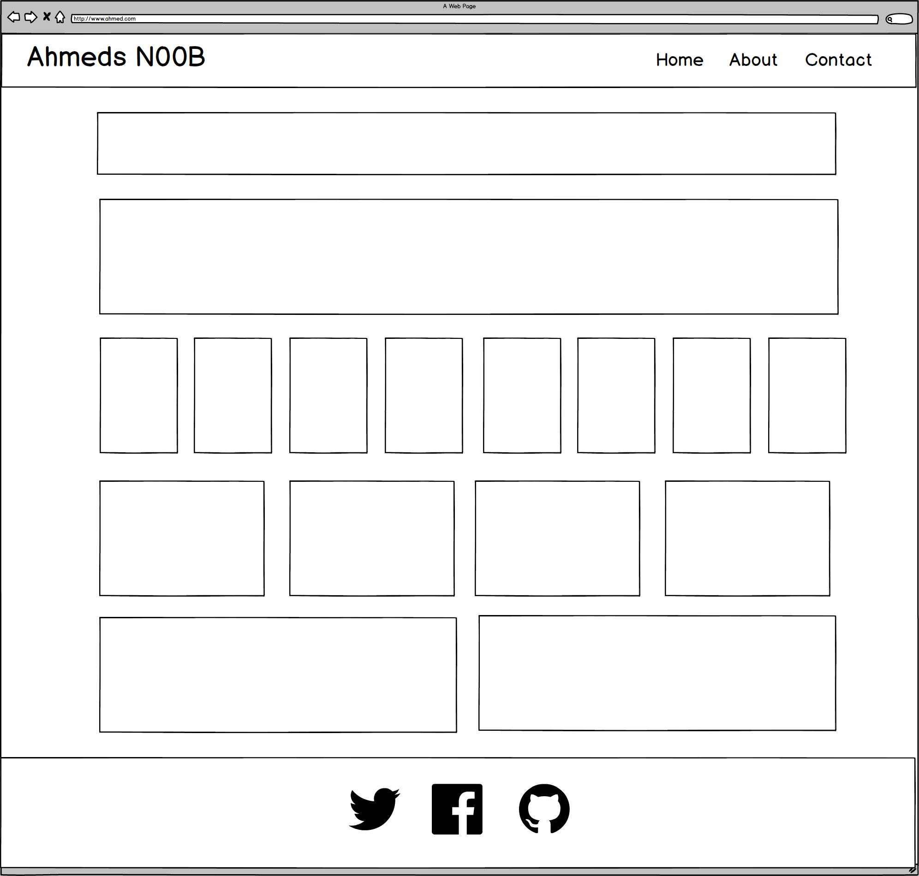
Notes:
7:00 – 7:05
20

Slide 21
ROWS
1
1
1
1
1
6 Total
1
Notes:
7:00 – 7:05
21

Slide 22
COLUMNS
1
1
8
4
2
1
Total Not relevant
Notes:
7:00 – 7:05
22

Slide 23
You Try!
Notes:
7:00 – 7:05
23

Slide 24
Level Up!
Now, let’s make it more challenging…

Slide 25
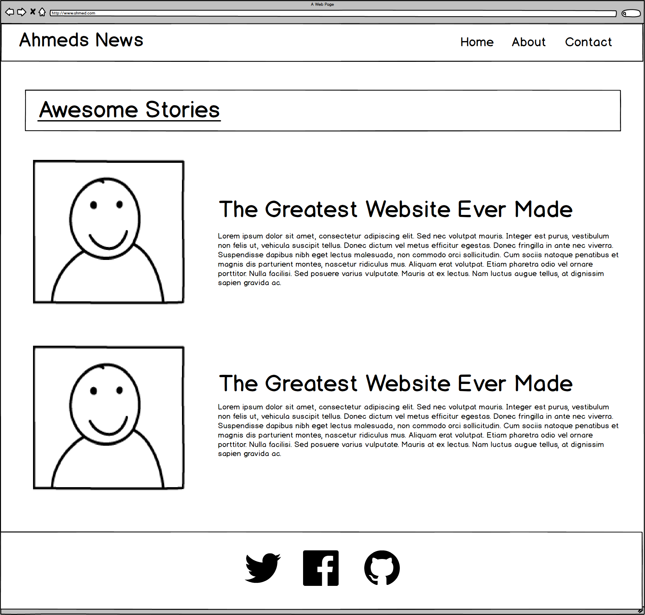
Notes:
7:00 – 7:05
25

Slide 26
ROWS
1
1
1
4
Total
1
Notes:
7:00 – 7:05
26

Slide 27
COLUMNS
1
2
2
1
Total Not relevant
Notes:
7:00 – 7:05
27

Slide 28
Level Up!
Now for another…

Slide 29
Notes:
7:00 – 7:05
29

Slide 30
ROWS
1
1***
1
4
Total
1
Notes:
7:00 – 7:05
30

Slide 31
COLUMNS
1
3
1
1
Total Not relevant
Notes:
7:00 – 7:05
31

Slide 32
You Try!
Notes:
7:00 – 7:05
32

Slide 33
Level Up!
This final one is tricky…

Slide 34

Notes:
7:00 – 7:05
34

Slide 35
Level Up!
Didn’t quite work right?
For this one we need sub-rows and sub-columns

Slide 36
ROWS
1
1***
1***
4
Total
1
Notes:
7:00 – 7:05
36

Slide 37
COLUMNS
1
2
1
Total Not relevant
Notes:
7:00 – 7:05
37

Slide 38
SUB-
ROWS
1
1
1
1
4
Total
Notes:
7:00 – 7:05
38

Slide 39
SUB-
COLUMNS
2
1
Notes:
7:00 – 7:05
39

Slide 40
You Try!
Notes:
7:00 – 7:05
40

Slide 41
Level Up
Real Example App
https://mean-google-maps.herokuapp.com/

Slide 42
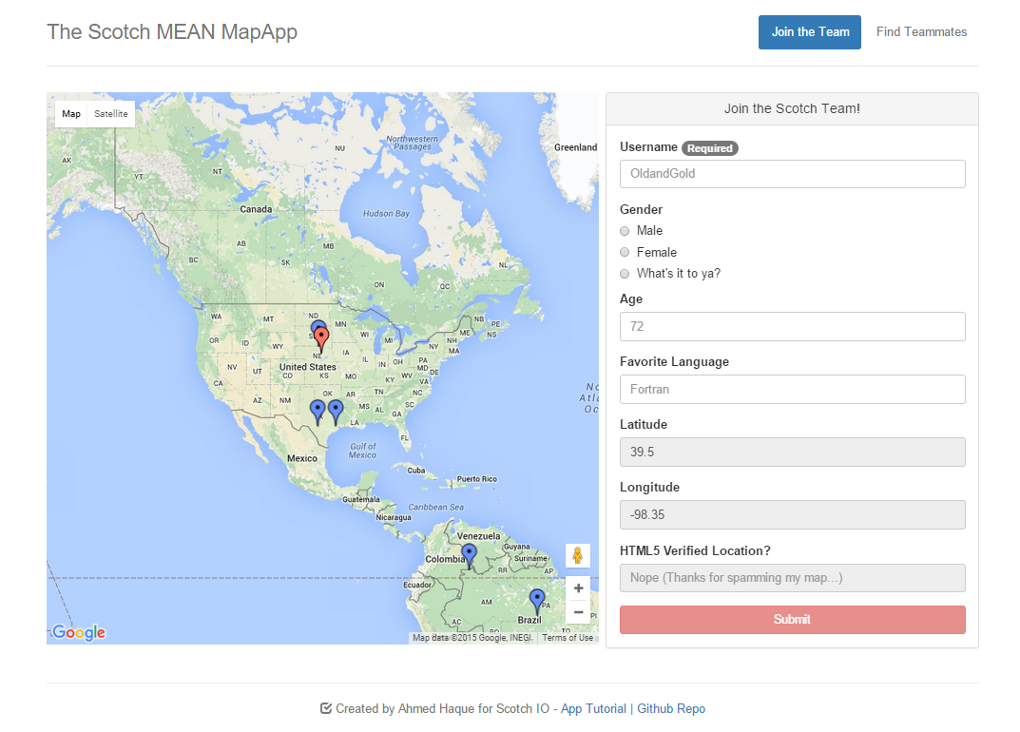
Notes:
7:00 – 7:05
42

Slide 43
ROWS
1
1
Notes:
7:00 – 7:05
43

Slide 44
COLUMNS
2
1
Notes:
7:00 – 7:05
44

Slide 45
Grid Design with Bootstrap

Slide 46
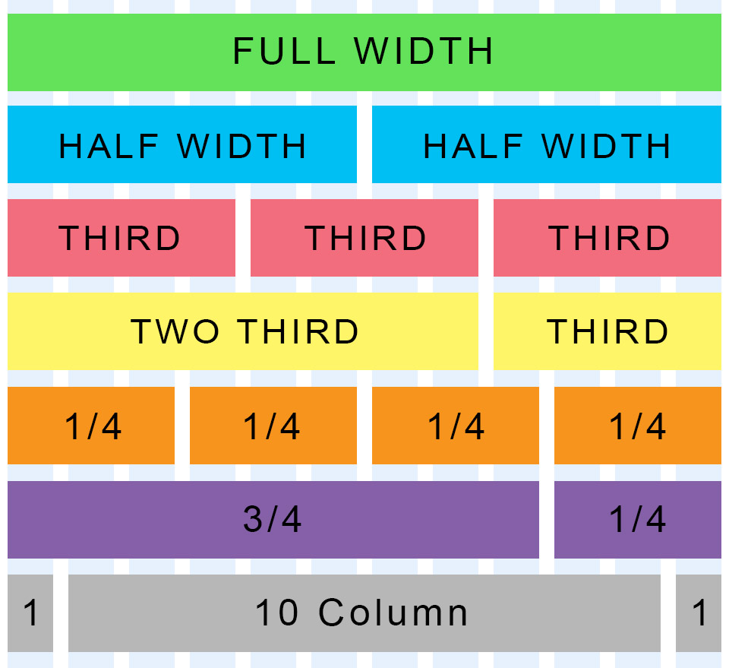
Bootstrap Grid
Bootstrap lets you organize content based on the “number of columns” a div spans – out of a total 12 columns.
Example:
<div class="col-md-12">
(Spans full width)
<div class="col-md-4">
(Spans 1/3 of full width)

Slide 47
Bootstrap Grids
Every Bootstrap Grids is made up of…
containers - which wrap around the entire grid)
rows - which are defined first and are just rows)
columns - which are defined within rows and specify the columns. The sum total of all columns within a row must add up to 12.
Each of these elements is implemented by creating a div with a specific class name.

Slide 48
Defining Columns
Container
Row #1
Column#1
Column#2
Column#3
Column#4

Slide 49

Bootstrap Grid
Note the rows, columns (col-lg-6), and containers

Slide 50
> YOUR TURN!!
Quick Activity:
Turn to your neighbors and explain to one another:
The relationship between containers, rows, and columns. (Draw it on a piece of paper for them)
The syntax for each.
The specific syntax details for columns.

Slide 51
Coding Grids

Slide 52
Bootstrap Grid
Note the rows, columns (col-lg-6), and containers

Slide 53

Bootstrap Grid
Note the rows, columns (col-lg-6), and containers

Slide 54

Defining Containers
“Containers” are like the box that the entire grid sits inside.

Slide 55

Defining Rows
“Rows” are like the rows we talked about earlier.

Slide 56

Defining Columns
“Columns” fit inside of rows. Note the syntax: col-sz-#
Col = column
sz = viewing size (in this case: medium)
# = number of “columns taken” out of 12. (in this case 4 of 12)

Slide 57
INSTRUCTOR DEMO!
Instructor: Demo
(quickgrid.html | 2-InstructorGrids)

Slide 58
> YOUR TURN!!
Activity:
Using Twitter bootstrap, create a layout that looks like the one shown on the next screen.
Spend some time prior to coding to draw out the grid layout
Count the number of rows and columns
Then use the bootstrap grid syntax to code it out.
Slack a screenshot of your page when you are done.
Ipsum Generator: http://www.lipsum.com/

Slide 59

> YOUR TURN!!

Slide 60
Building Bootstrap Layouts

Slide 61
INSTRUCTOR DEMO!
Instructor: Demo
(InClass-DemoLayout.html | 4-InstructorLayout)

Slide 62
> YOUR TURN!!
Activity:
Working in pairs and using Twitter Bootstrap make the following design.
Be sure to note the:
Grid Layout
Navbar
Sidebar panel
Thumbnail
Additional details will be sent to you via slack.

Slide 63
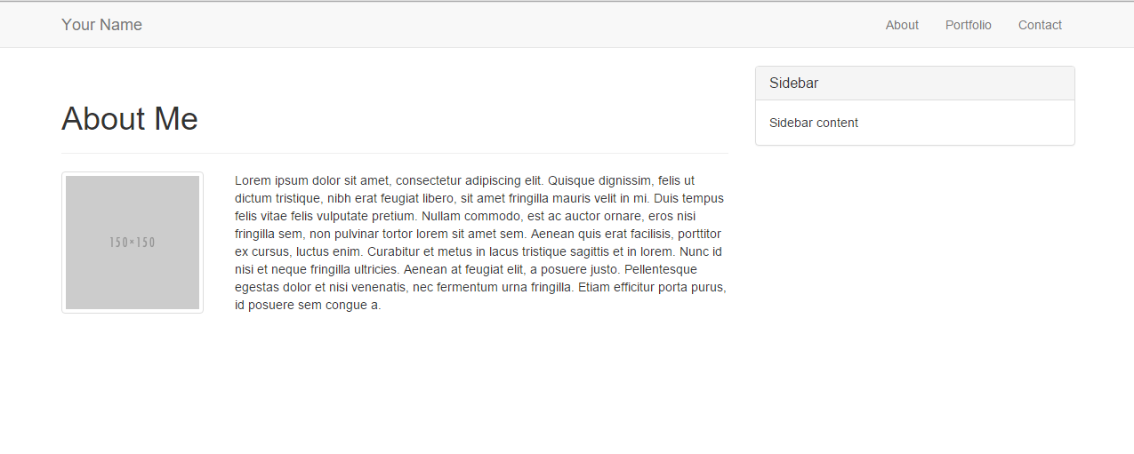
> YOUR TURN!!

Slide 64
Common Questions
Can I reverse the order (i.e. rows inside columns)? No. Columns always go inside of rows. Though, you can create sub-rows inside of columns. But those columns would still need to be inside of a row of their own.
Can I just avoid having a container? You could… But it will mess things up. Just throw in a container.
What if I have columns that go past 12? Then your bootstrap grid will behave wildly. Don’t go past 12.
What if I don’t add up to 12? Nothing. You will have empty space at the end. But be careful, because the next column you add will fill up the empty space (sometimes without your intention).

Slide 65
Mobile Responsive (HW)

Slide 66

Still No Facebook Time
Warning!
This next section matters a lot for your homework

Slide 67
Media Queries
Media Queries define how CSS styles are applied in relation to the characteristics of the viewing device.
Through media queries we can change the way a webpage is displayed based on width, height, orientation, and even resolution.
Bootstrap extensively uses media queries to help you create mobile responsive websites.
But remember! Order matters!

Slide 68
INSTRUCTOR DEMO!
Instructor: Demo
(6-InstructorMedia)

Slide 69
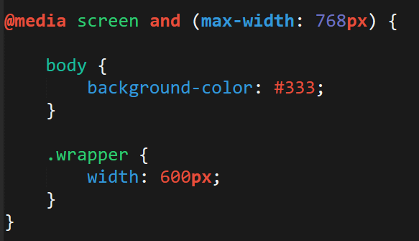
> YOUR TURN!!
Activity:
Explain to your partner what the following CSS code does:

Slide 70
> YOUR TURN!!
Activity:
Build your own mobile responsive HTML /CSS page using media queries.
Just follow the steps sent to you via Slack.

Slide 71
Viewport
Viewport is the user’s visible area of a web page.
Viewport controls how a web page is displayed on a mobile device. Without this, mobile devices would render the page at a typical desktop screen (scaled down).

Slide 72


Viewport
No Viewport
Yes Viewport

Slide 73
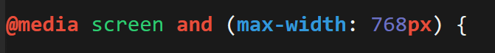
Viewport Inclusion
Just include this line in the head
And then include a variety of @media queries for various sized screens.

Slide 74
> YOUR TURN!!
Activity:
Spend the next few moments on the site viewportemulator.com and visit your favorite websites using various viewports.
Notice how the sites change display wise.

Slide 75
Questions?
Notes:
75

Slide 76
Extra Challenge
Time Permitting

Slide 77
> YOUR TURN!!
Activity:
With those around you (and using Twitter Bootstrap), create a complex layout of your own.
You can use the layout provided to you as a guide, starting point, inspiration, or not at all.

Slide 78
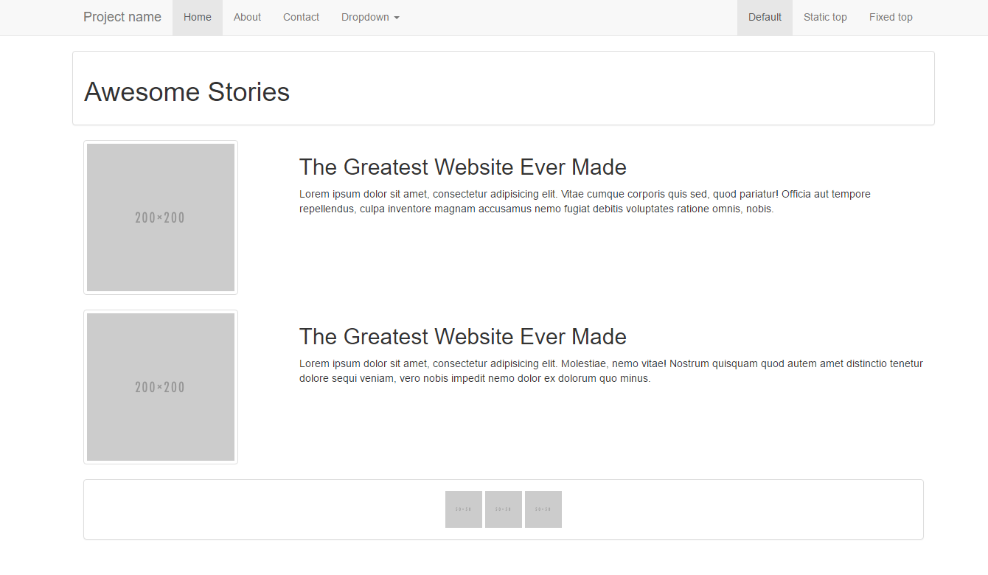
Notes:
78

